Slide 1
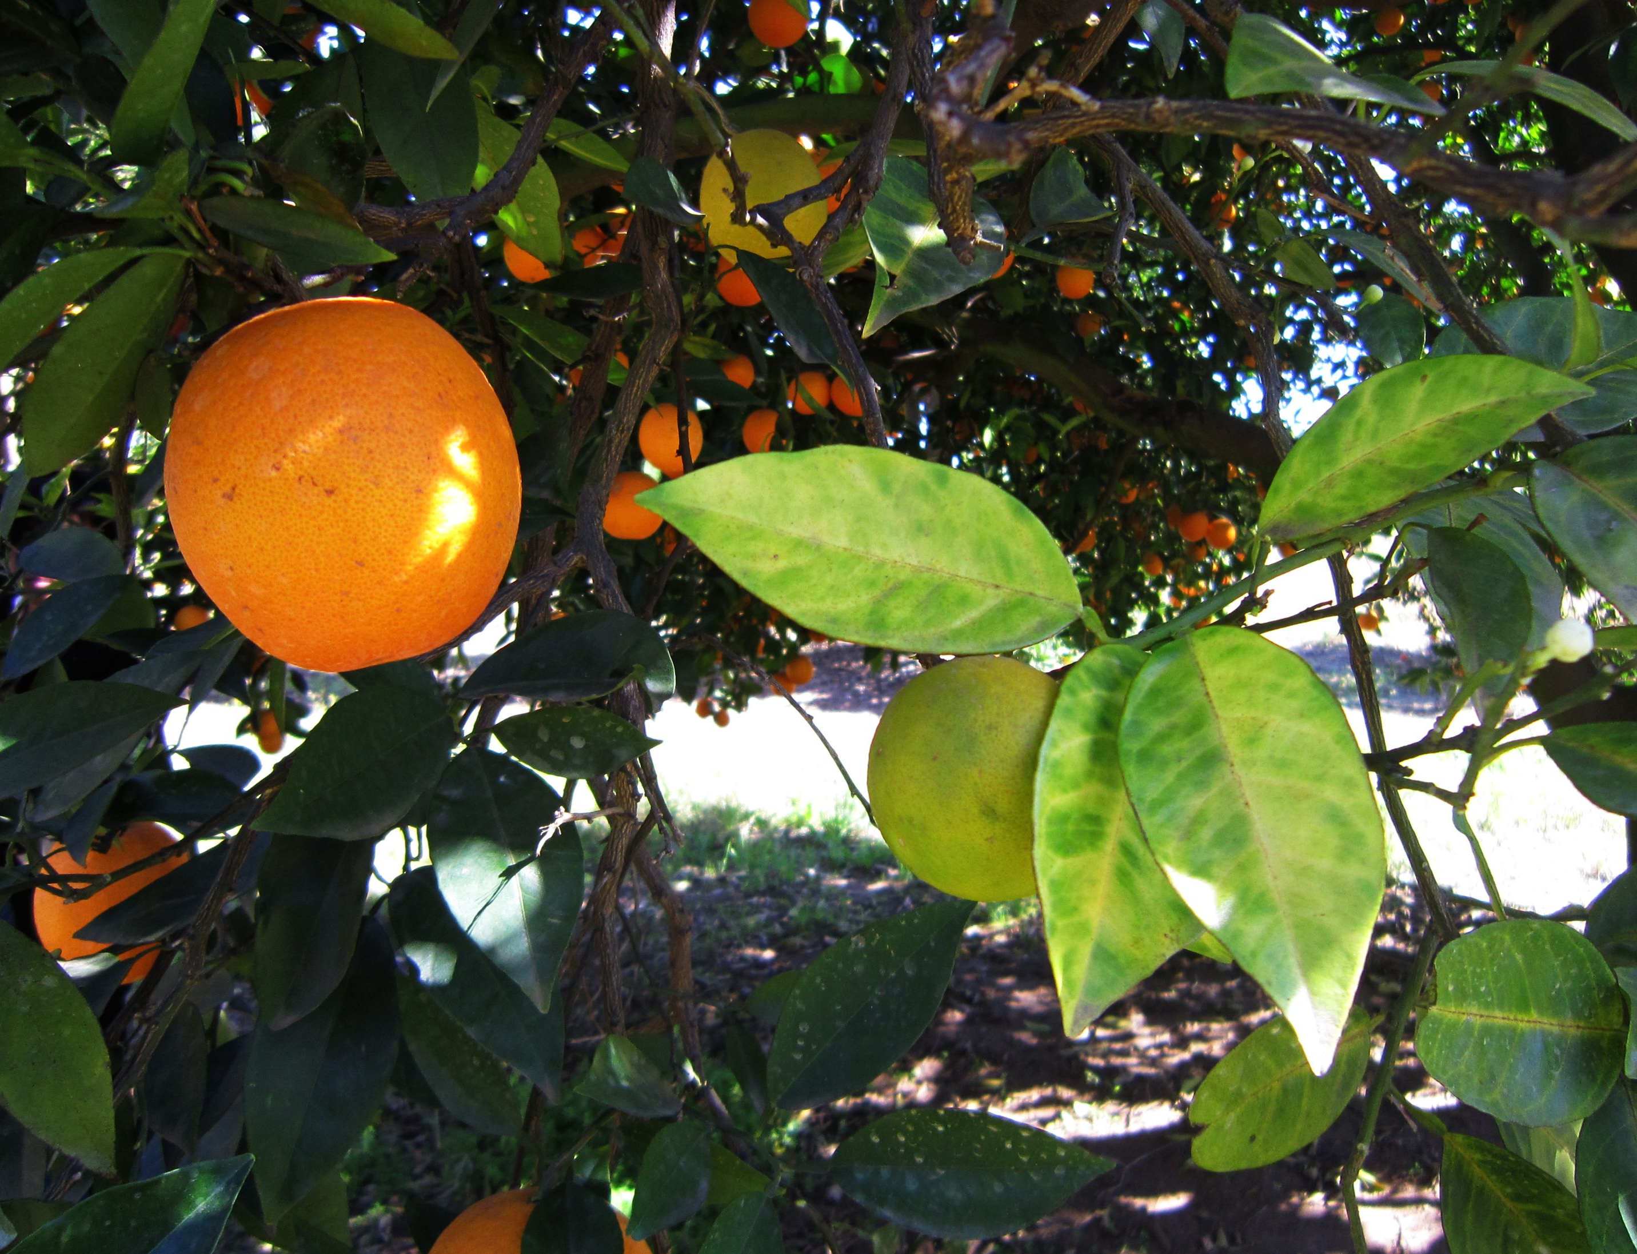
Crop Disease: Citrus
Nina Prouty Candidate7433 US213
(Citrus greening disease, 2021)

Slide 2
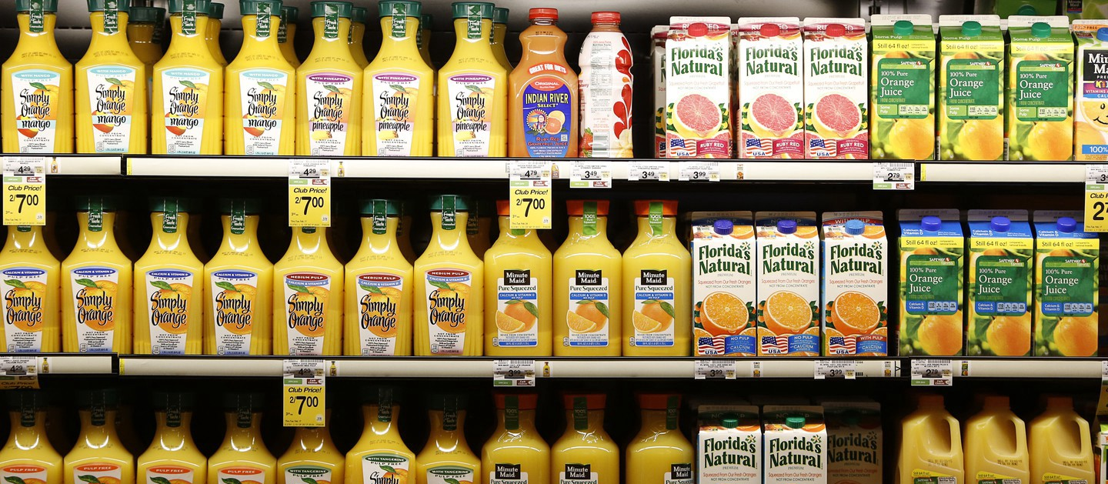
(Orange juice aisle, 2021)
Notes:
1. No hook label

Slide 3
(Orange juice aisle, 2021)

Slide 4
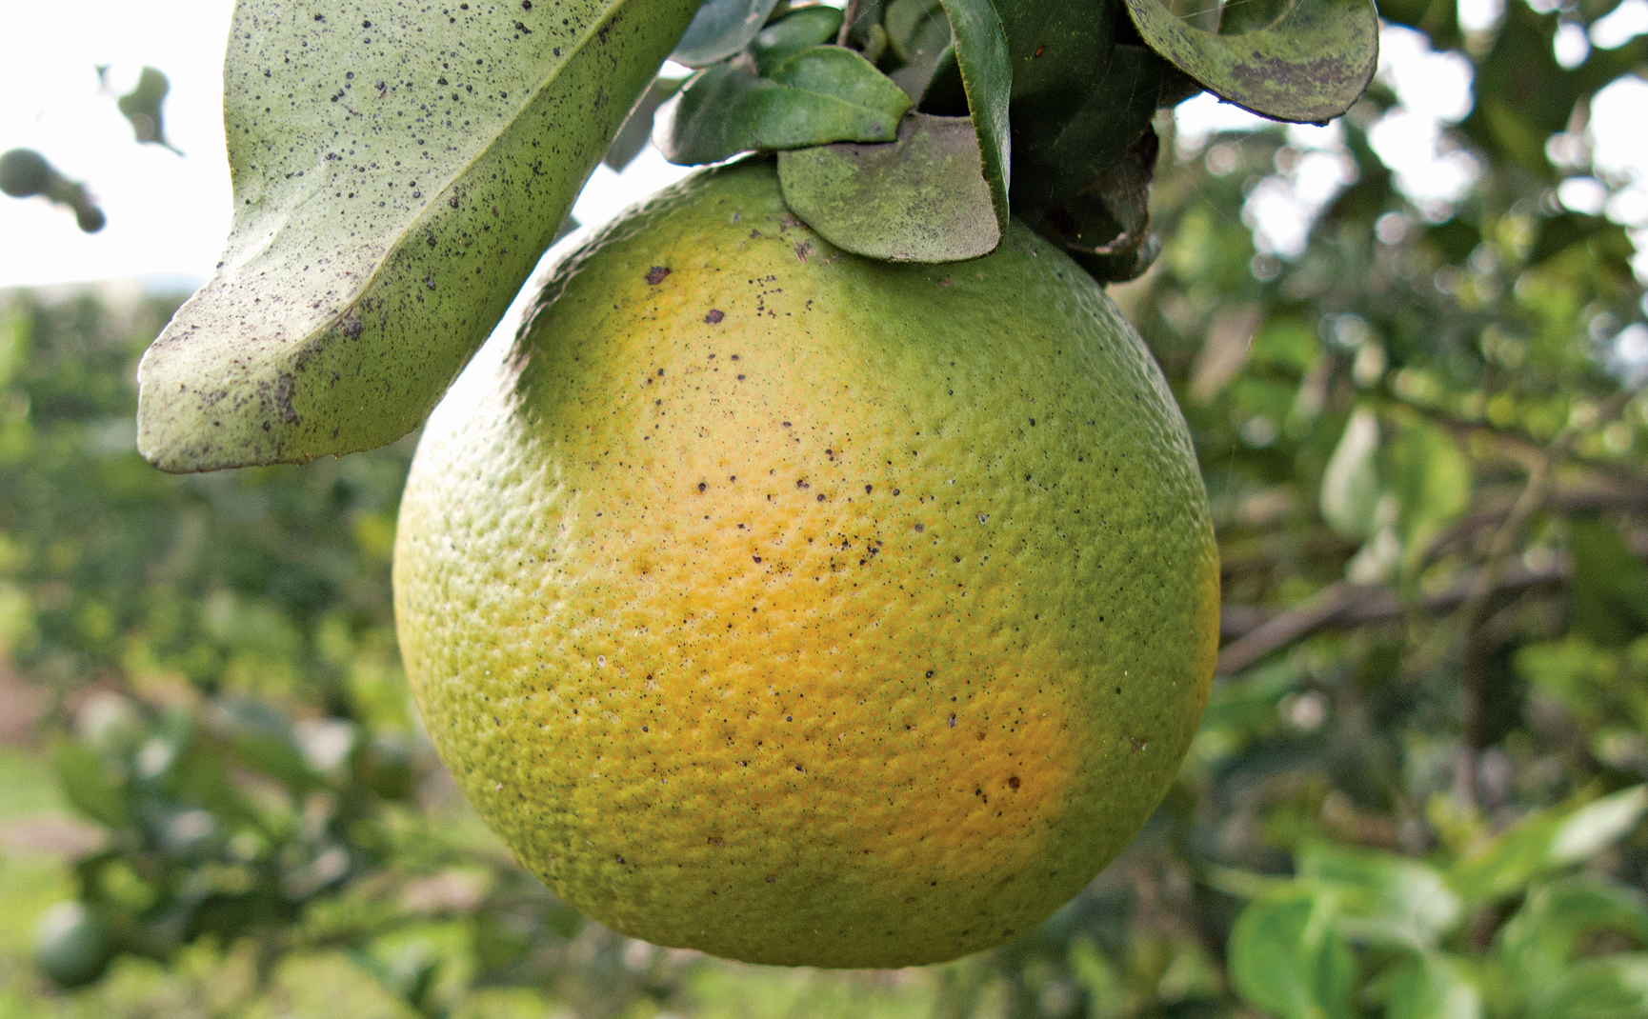
HUANgLONGBING (Citrus Greening)
(Citrus greening disease, 2021)
Notes:
2. Explain the problem

Slide 5
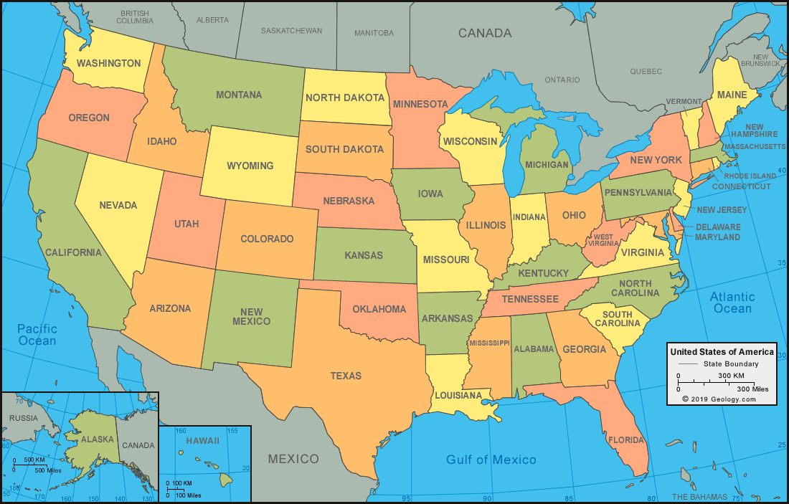
LOCAL PROBLEM
(United States map, 2021)
Notes:
3. Local problem: why is it a problem here

Slide 6
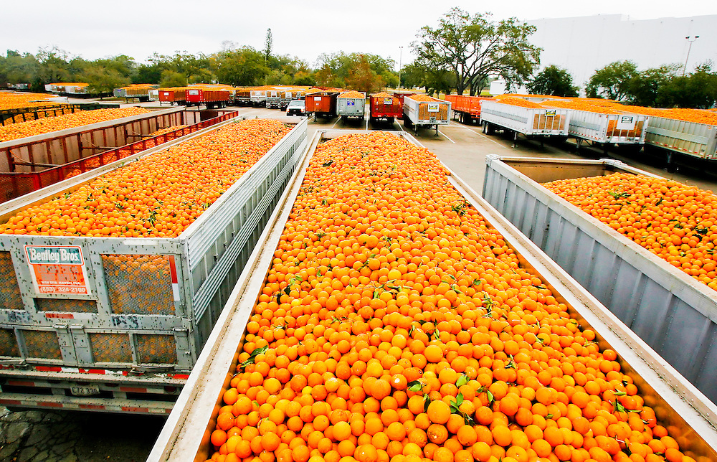
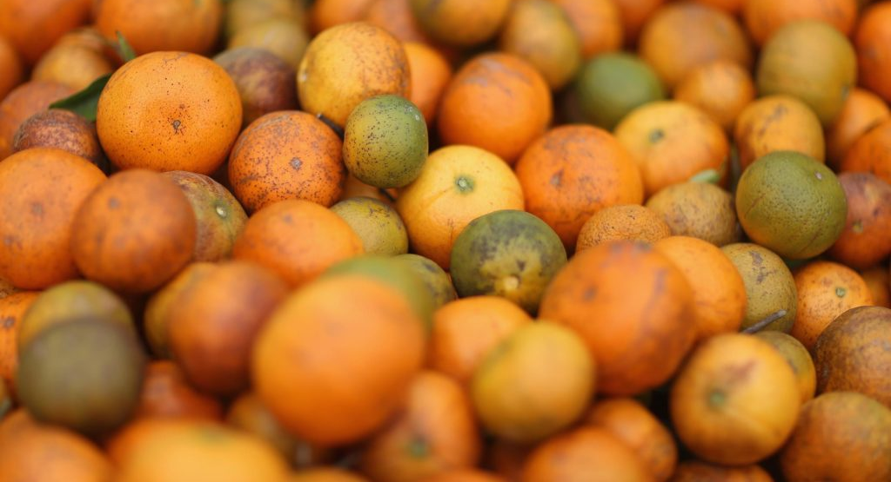
(Tropicana plant Bradenton FL, 2021)
(Citrus greening, 2021)

Slide 7
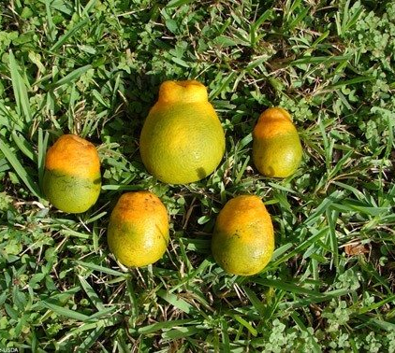
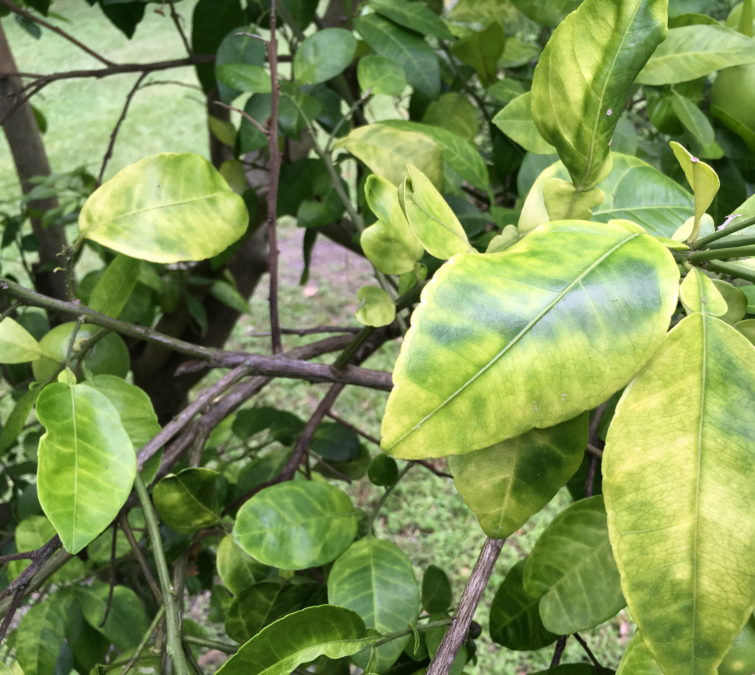
Crop Disease in Citrus
(Citrus greening disease, 2021)
(Citrus greening disease, 2021)

Slide 8
Lenses
CITRUS DISEASE
Scientist
Government
Environment
Economic
Notes:
4. Define perspectives FULLY

Slide 9
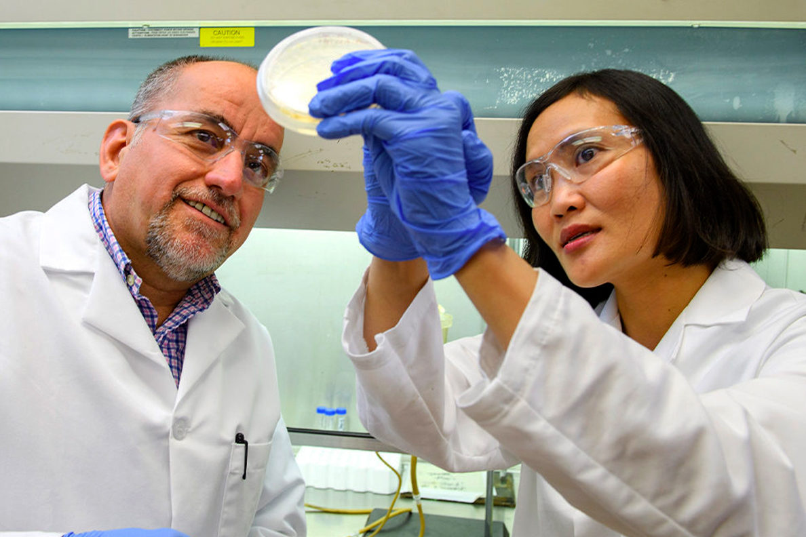
SCIENTIST LENS
(Citrus greening researcher, 2021)
(Scientist, 2021)

Slide 10
Reasons
IMPLEMENTATION
DISAGREEMENT
Notes:
Add lens to reasons slide: make point obvious

Slide 11
Implementation
IMPLEMENTATION
DISAGREEMENT

Slide 12
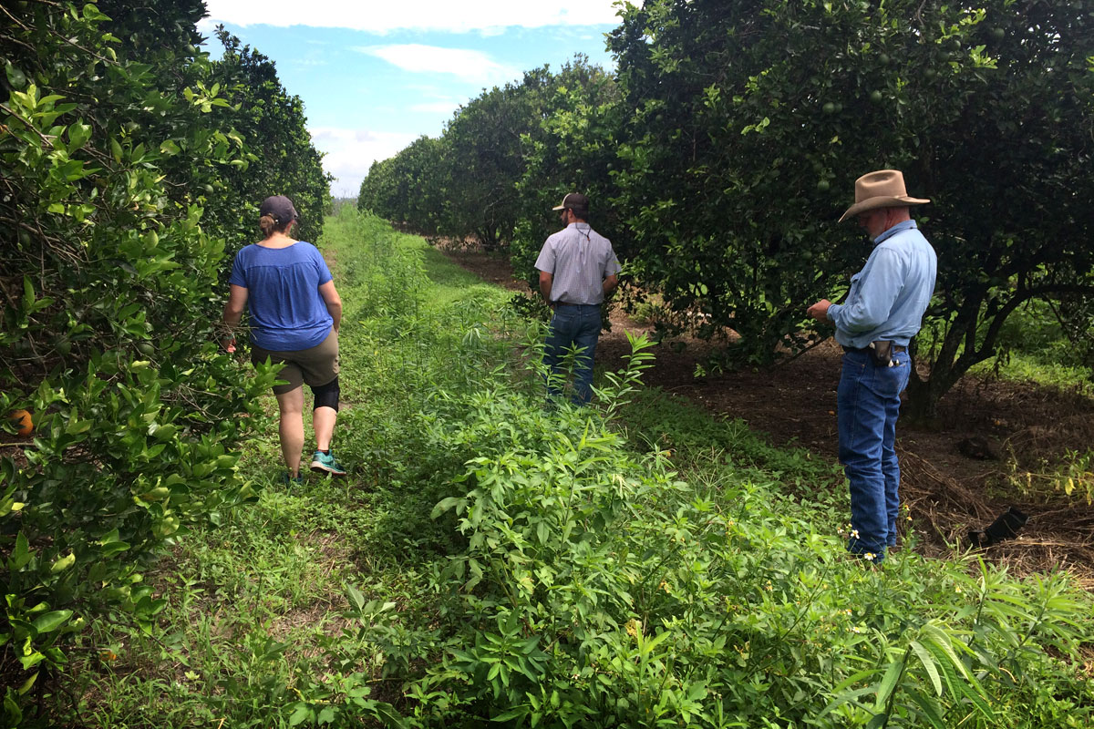
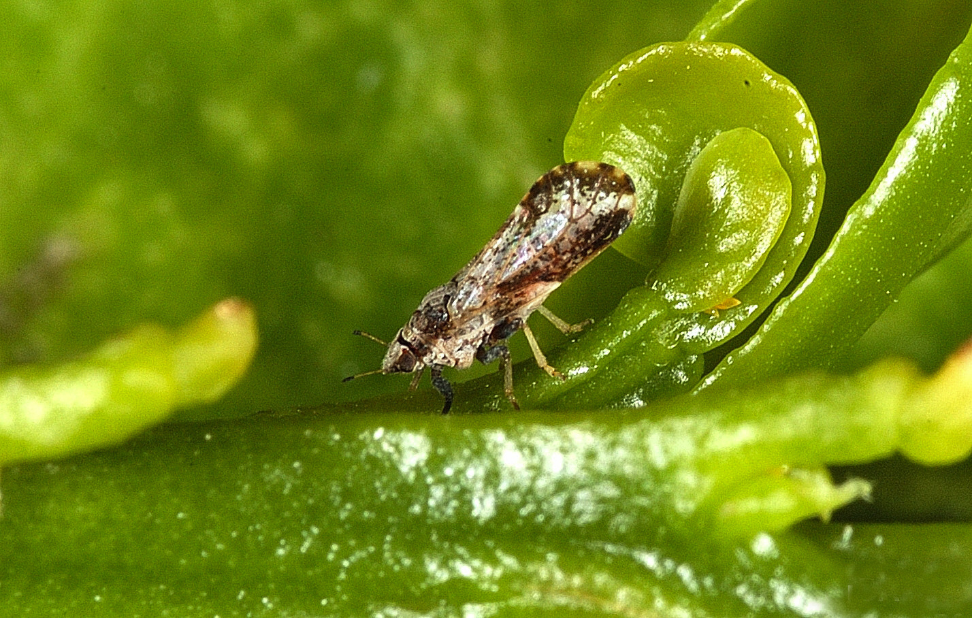
Implementation
IMPLEMENTATION
Farmer Reluctance
(Citrus fruit farmer Florida, 2021)
(Diaphorina citri, 2021)
Notes:
Add local/global

Slide 13
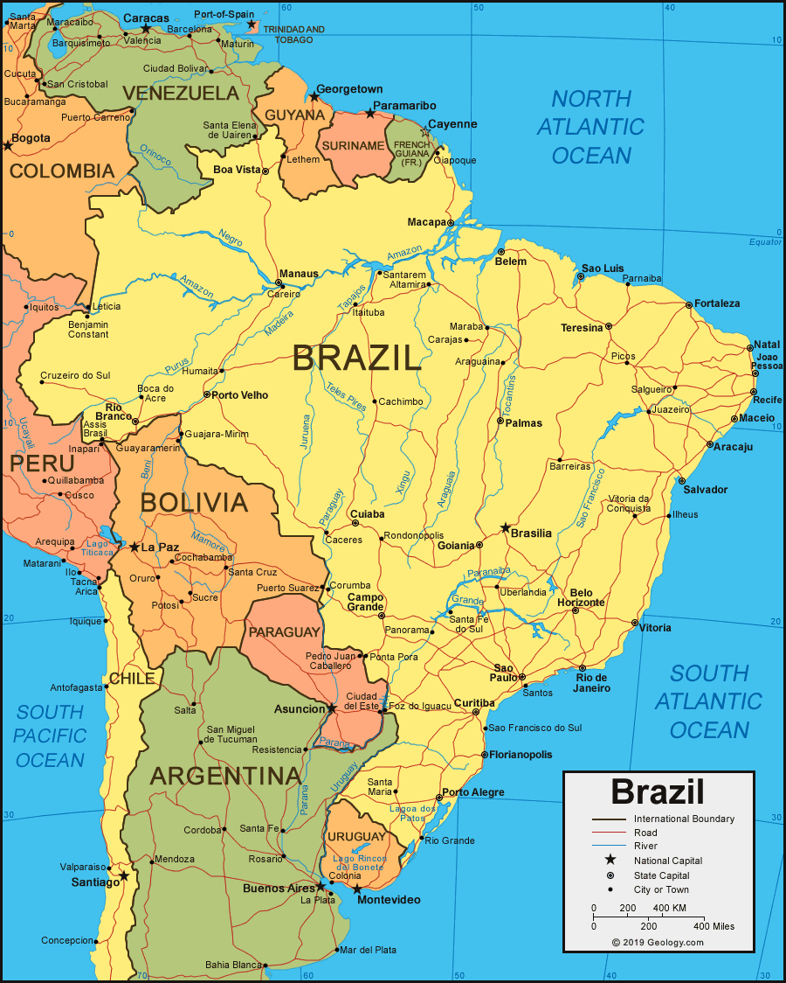
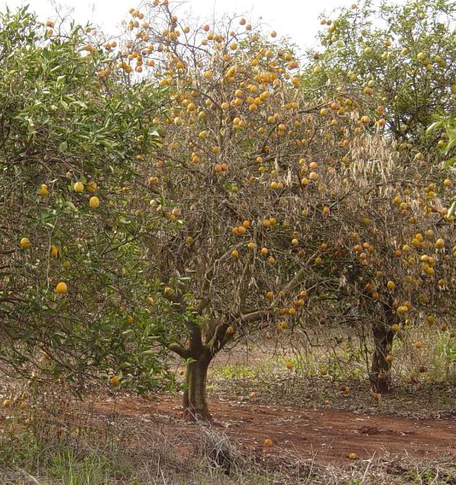
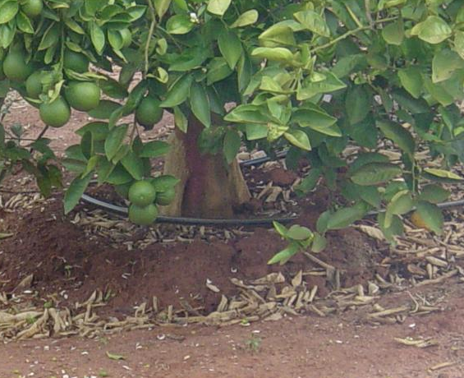
Implementation
IMPLEMENTATION
(Brazil map, 2021)
Farmer Reluctance
Niche/Inefficient
(Beretta, Futch & Derrick, 2020)
(Beretta, Futch & Derrick, 2020)
Inarched Tree
Rootstocks: growths that can be used to propagate other varieties of plant

Slide 14
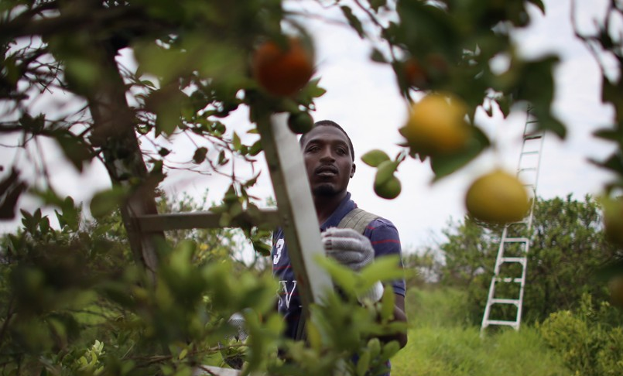
DISAGREEMENT
IMPLEMENTATION
DISAGREEMENT
Farmer Reluctance
Niche/Inefficient
Methods
(Antibiotics, 2021)
(Antibiotics on citrus trees, 2021)

Slide 15
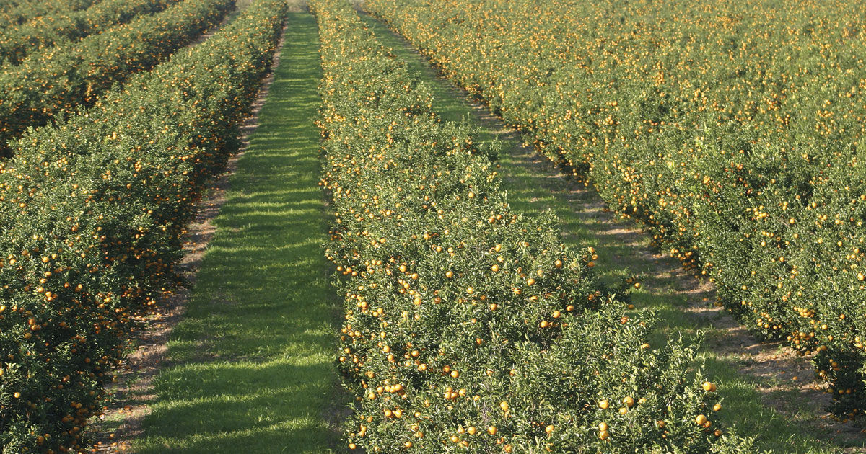
DISAGREEMENT
IMPLEMENTATION
DISAGREEMENT
Farmer Reluctance
Niche/Inefficient
Methods
Regulations vs. Research
28%
(Citrus greening Brazil, 2021)

Slide 16
Recap
IMPLEMENTATION
Farmer Reluctance
Niche/ Inefficiency
Methods
DISAGREEMENT
SOLUTIONS?
Regulations vs. Research
Notes:
Add lens to recap slide

Slide 17
Solutions
PEPTIDES
R GENES

Slide 18
Solutions
PEPTIDES
R GENES

Slide 19
peptides
PEPTIDES
(Vismax, 2021)

Slide 20
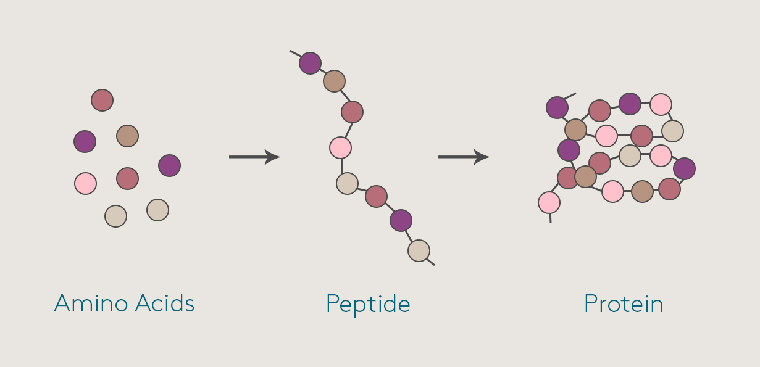
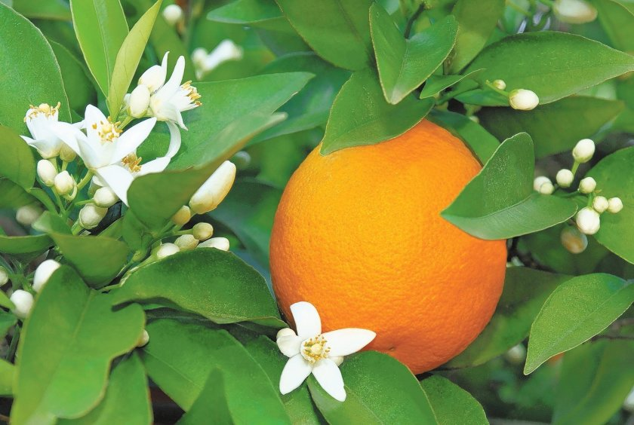
(Elemental Enzymes, 2021)
PEPTIDES
(Peptides, 2021)
(Healthy orange tree, 2021)

Slide 21
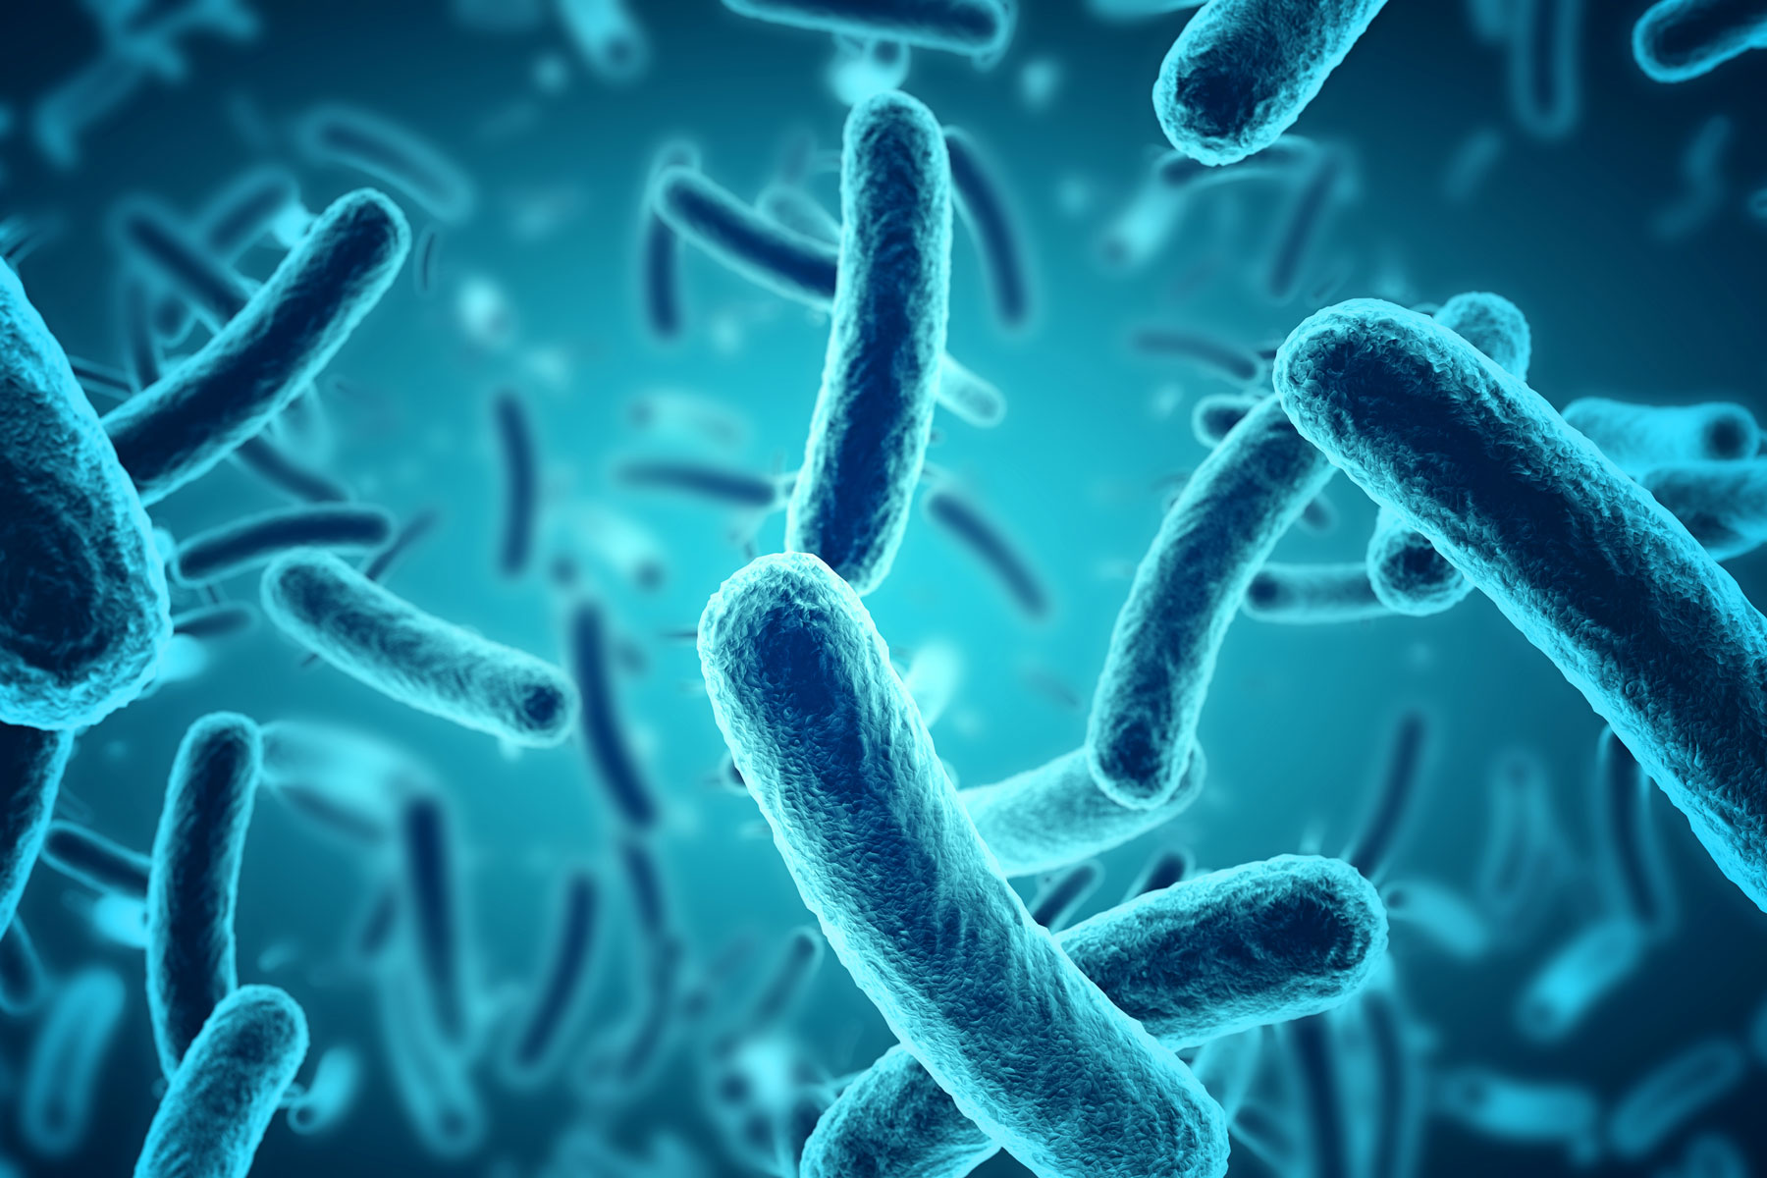
R Genes
PEPTIDES
R GENES

Slide 22
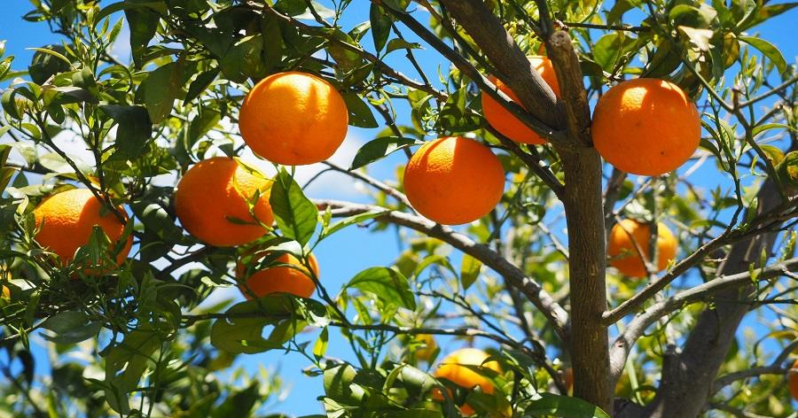
PEPTIDES
R GENES
(Orange tree, 2021)
(R genes simple, 2021)

Slide 23
Innovative solution: 3 STEP plan
PHASE 1: EDUCATION
PHASE 2: CREATION
PHASE 3: IMPLEMENTATION

Slide 24
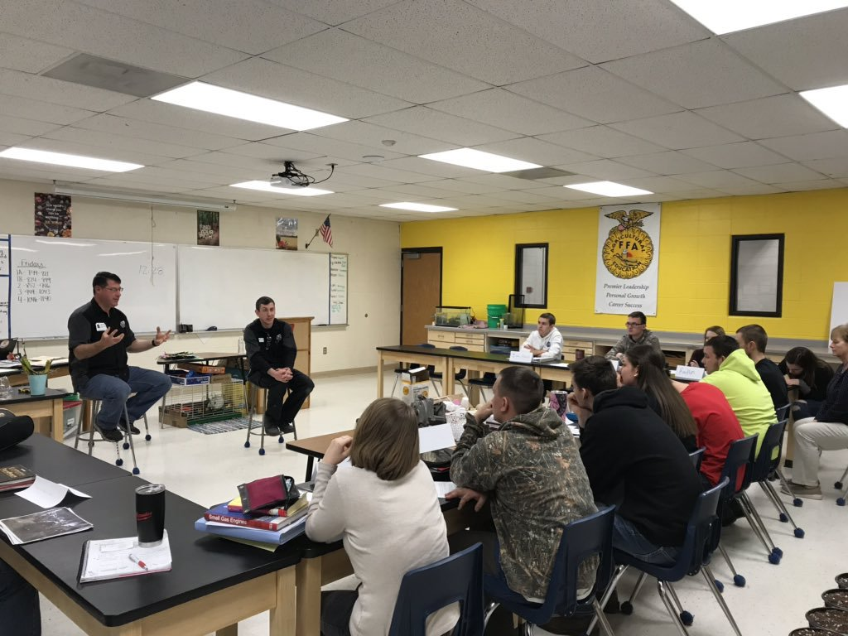
PHASE 1: EDUCATION
(Science teacher, 2021)
(Agriscience, 2021)

Slide 25
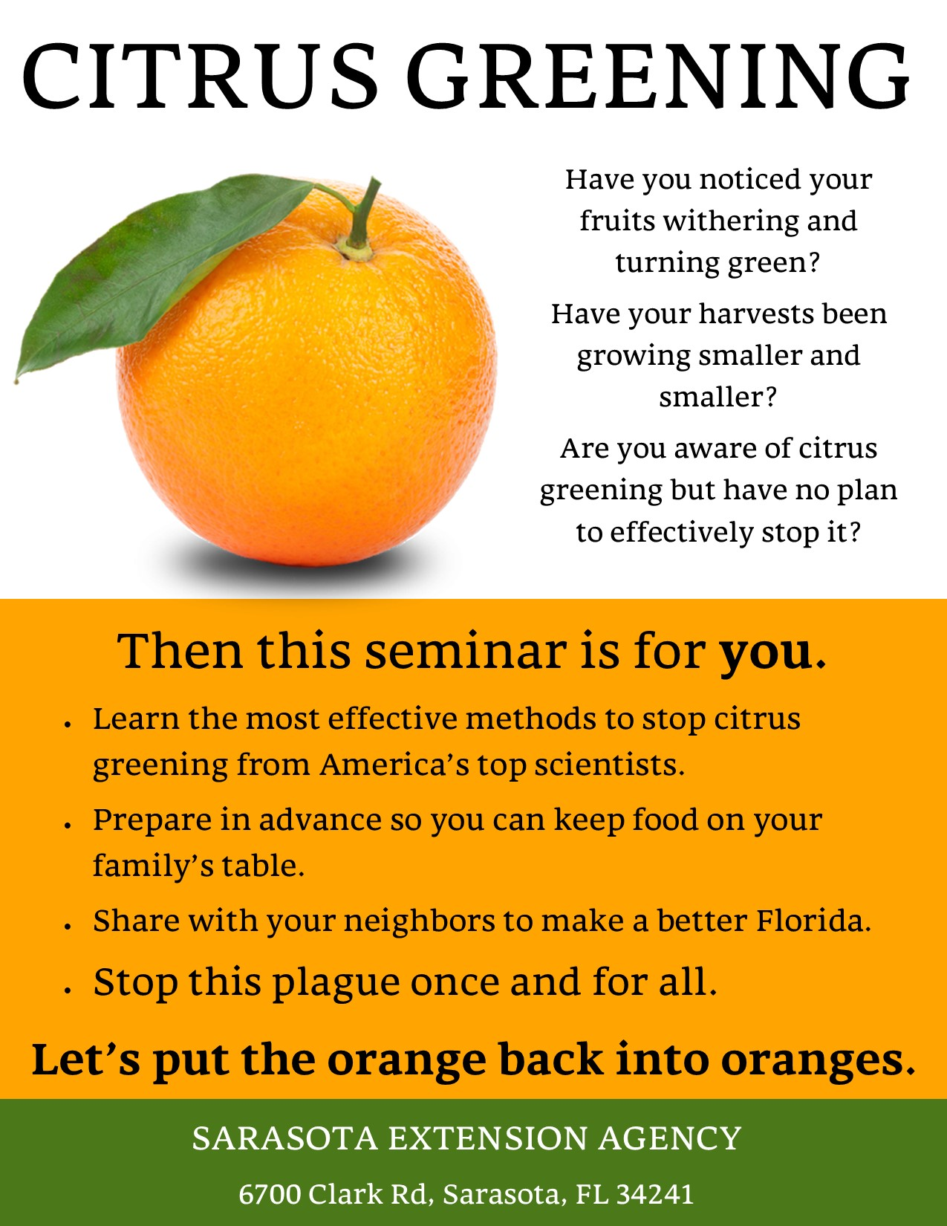
(Nina Prouty, 2021)

Slide 26
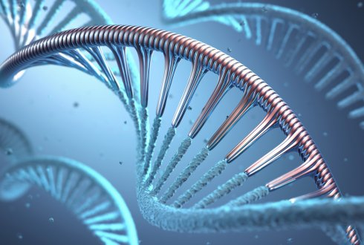
PHASE 2: CREATION
(Government grant, 2021)
(Genetic modification, 2021)
(Vismax, 2021)

Slide 27
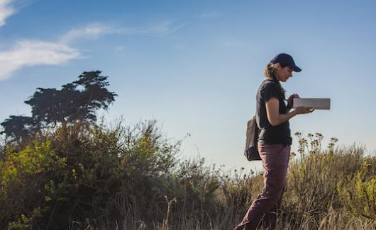
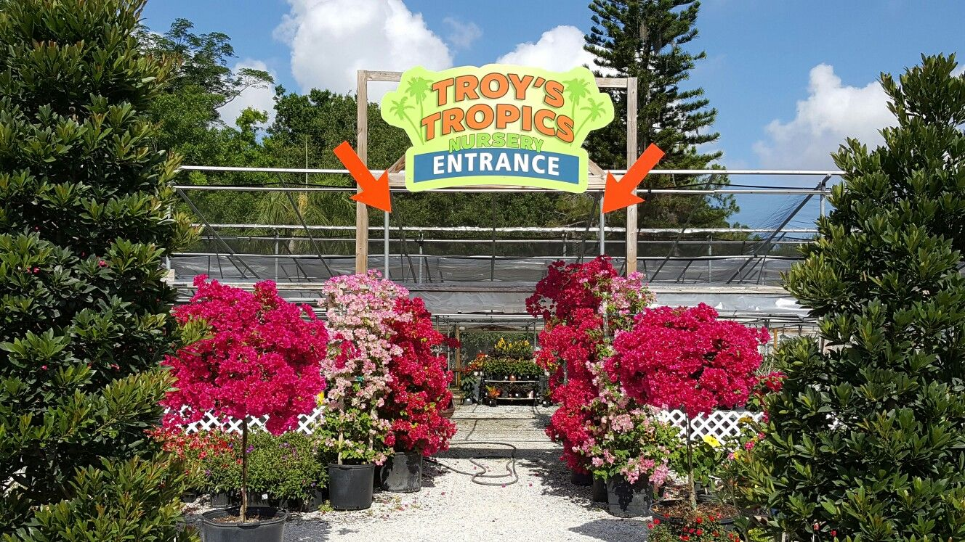
PHASE 3: Implementation
(Troy’s Tropics, 2021)
(Field researcher, 2021)
(Government giving money, 2021)

Slide 28
CITRUS GREENING
IMPLEMENTATION
DISAGREEMENT
PEPTIDES
R GENES

Slide 29
References
[Agriscience/FFA meeting]. (2012). Retrieved 2021, from https://www.mishicotffa.org/power--ag-mechanics.html
[Antibiotics]. (2021). Retrieved 2021, from https://uhs.umich.edu/antibiotics
[Bacteria]. (2018, February 12). Retrieved 2021, from https://news.usc.edu/135660/how-bacteria-adapt-to-hostile-environments/
[Brazil map]. (2021). Retrieved 2021, from https://geology.com/world/brazil-satellite-image.shtml
[Citrus fruit farmer Florida]. (2017, December 18). Retrieved 2021, from https://citrusindustry.net/2017/12/18/uf-ifas-tropicana-test-citrus-greening/
[Citrus greening disease]. (2019, April 8). Retrieved 2021, from https://newswire.caes.uga.edu/story.html?storyid=7928&story=Citrus-Crop
[Citrus greening disease]. (2019, June 9). Retrieved 2021, from https://cen.acs.org/biological-chemistry/biochemistry/Citrus-greening-killing-worlds-orange/97/i23
[Citrus greening disease]. (2021, February 1). Retrieved 2021, from https://www.gardeningknowhow.com/edible/fruits/citrus/citrus-greening-disease.htm
[Citrus greening in countries]. (2018). Retrieved 2021, from https://www.mitogrow.com/citrus-greening-disease/
[Citrus greening]. (2019, October 23). Retrieved 2021, from https://agrilifetoday.tamu.edu/2019/10/23/citrus-greening-quarantine-expands-to-brazoria-galveston-counties/
[Diaphorina citri]. (2020, December 10). Retrieved 2021, from https://en.wikipedia.org/wiki/Diaphorina_citri#/media/File:Asian_Citrus_Psyllid_adult.jpg
[Elemental Enzymes logo]. (2021). Retrieved 2021, from https://elementalenzymes.com/
[Field researcher]. (2018). Retrieved 2021, from https://www.ehs.ucsb.edu/field-safety/planning-checklist-field-researcher
[Florida map]. (2021). Retrieved 2021, from https://geology.com/state-map/florida.shtml
[Genetic modification]. (2019). Retrieved 2021, from https://www.wur.nl/en/Dossiers/file/Genetic-modification-1.htm
[Government grant]. (2020, November 23). Retrieved 2021, from https://www.investopedia.com/terms/g/government-grant.asp
[Government money graphic]. (2018, August 27). Retrieved 2021, from https://www.firstquotehealth.com/health-insurance-news/obamacare-helps-you-pay-for-health-insurance-heres-how
[Healthy orange tree]. (2012, July 20). Retrieved 2021, from https://www.sandiegouniontribune.com/lifestyle/home-and-garden/sdut-tips-for-healthy-citrus-trees-2012jul20-story.html
[Orange tree]. (2019, September 16). Retrieved 2021, from https://uscitrus.com/blogs/citrus-simplified/5-things-you-should-know-about-planting-orange-trees
[Peptide formation]. (2018, July 11). Retrieved 2021, from https://www.colorescience.com/blogs/learn/peptides-for-skin
[Sarasota extension agency]. (2020, June 12). Retrieved 2021, from http://blogs.ifas.ufl.edu/sarasotaco/

Slide 30
References
[Scientist]. (2019, July 29). Retrieved 2021, from https://www.forbes.com/sites/jonyounger/2019/07/29/scientists-are-a-new-force-in-the-freelance-revolution-meet-kolabtree/?sh=21793db7505d
[Teacher]. (2019, February 19). Retrieved 2021, from https://today.tamu.edu/2019/02/19/study-finds-high-school-teacher-impacts-carry-into-college-and-beyond/
[Troy's Tropics entrance]. (2021). Retrieved 2021, from https://www.pinterest.fr/pin/425519864774368057/
[United States map]. (2021). Retrieved 2021, from https://geology.com/world/the-united-states-of-america-satellite-image.shtml
[Vismax logo orange background]. (2021). Retrieved 2021, from https://elementalenzymes.com/vismax/
[Vismax logo]. (2021). Retrieved 2021, from https://elementalenzymes.com/2020/10/21/vismax-in-the-news/
Barron, C. L. (2021). Aerial view of orange grove - Winter Garden, Florida. [Digital image]. Retrieved 2021, from http://www.floridamemory.com/items/show/156985
Beretta, M. J., Futch, S. H., & Derrick, K. S. (2020, October 27). Citrus Sudden Death in Brazil. Retrieved January 19, 2021, from https://edis.ifas.ufl.edu/hs243
Brown, H. C. (2020, February 18). To combat citrus greening, farmers are spraying antibiotics on their trees. Retrieved January 18, 2021, from https://thecounter.org/citrus-greening-florida-farmers-medically-important-antibiotics/
Cameron, G. (2020, April 22). [Orange juice aisle]. Retrieved 2021, from https://medium.com/better-marketing/the-worst-rebrand-in-the-history-of-orange-juice-1fc68e99ad81
Craig, AP, Cunniffe, NJ, Parry, M, Laranjeira, FF, Gilligan, CA. Grower and regulator conflict in management of the citrus disease Huanglongbing in Brazil: A modelling study. J Appl Ecol. 2018; 55: 1956– 1965. https://doi.org/10.1111/1365-2664.13122
Gururani, M. A. (2012, January). Plant pathogen interaction and development of disease resistance. [Digital image]. Retrieved 2021, from https://www.researchgate.net/figure/Plant-pathogen-interaction-and-development-of-disease-resistance_fig1_258021859
Illustration of X chromosomes [Digital image]. (2018, April 9). Retrieved 2021, from https://daily.jstor.org/the-secrets-of-the-x-chromosome/
Litherland, C. (2009, January 13). [Tropicana plant Bradenton FL]. Retrieved 2021, from https://chiplitherland.photoshelter.com/image/I0000q.BvJjBAZPA
National Academies of Sciences, Engineering, and Medicine 2018. A Review of the Citrus Greening Research and Development Efforts Supported by the Citrus Research and Development Foundation: Fighting a Ravaging Disease. Washington, DC: The National Academies Press. https://doi.org/10.17226/25026.
Orange PNG Transparent Images [Digital image]. (2019). Retrieved 2021, from http://clipart-library.com/clipart/orange-png-clipart.htm
Raedle, J. (2019, March 19). [Antibiotics on citrus trees]. Retrieved 2021, from https://www.nature.com/articles/d41586-019-00878-4
Santos, H. (2018, January). [Citrus greening Brazil]. Retrieved 2021, from https://revistapesquisa.fapesp.br/en/biological-control-against-citrus-greening/
Vidalakis, G. (2018, June 6). [Citrus greening disease]. Retrieved 2021, from https://www.pe.com/2018/06/06/want-to-help-fight-citrus-greening-disease-take-the-leaves-off-that-orange-before-sharing-it/

